Slide 1
Post COVID Stock Portfolio Dashboard Development
“KJAM” Group
Project #4
Kyle Eaton
Javon Seaforth
Amit Sharma
Mako Barre

Slide 2
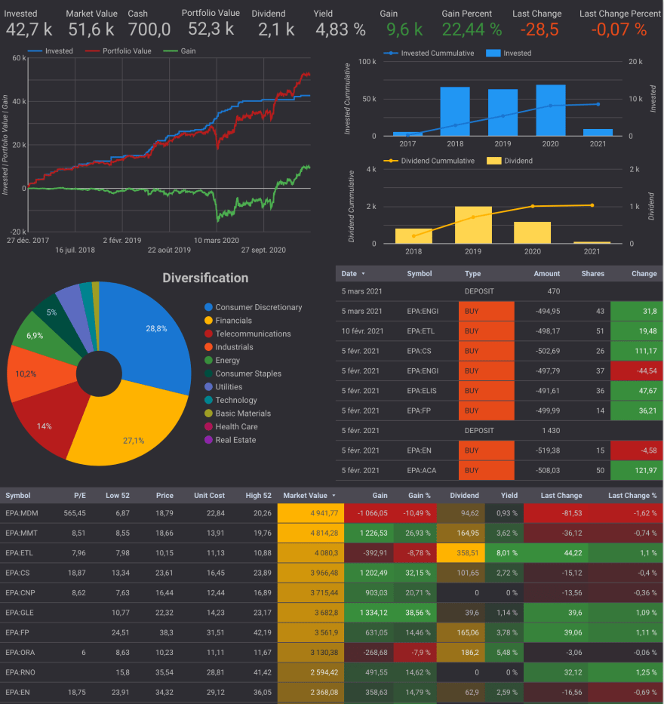
Overview
Introduction
Dataset
Tools/Process
Methodology
Data Visualization
Conclusion

Slide 3

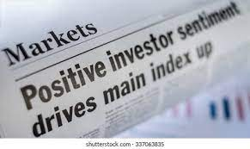





Introduction
COVID-19 impact to travel, hospitality & retail
(11) companies analyzed
Machine Learning employed
Goal: KJAM equity dashboard = quarterly/daily stock returns

Slide 4
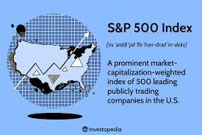

Dataset
Stock price and volume data over 7 years (2017 – 2023)
~17,600 rows of daily closing price and volume data = SQlite3 database
Post-COVID (2022/2023)

Slide 5







Tools/Process
SQLite DB -> Python
RF -> Jupyter Notebooks
FinViz -> NLTK/VADER (sentiment analysis)
LSTM -> CoLab
Models -> Flask -> HTML
Tableau – data visualization

Slide 6
Methodology
Sqlite Database (CSV file)
EDA/data cleaning
(python)
Random Forest Model (Machine Learning)
Long Short Term Memory Model (deep learning)
Sentiment Analysis Tool (webscraping/VADER/NLTK)
Data Visualizations
Flask app/HTML/CSS
Flask app/HTML/CSS
Flask app/HTML/CSS
Interactive User Interface (Stock Predictions)

Slide 7
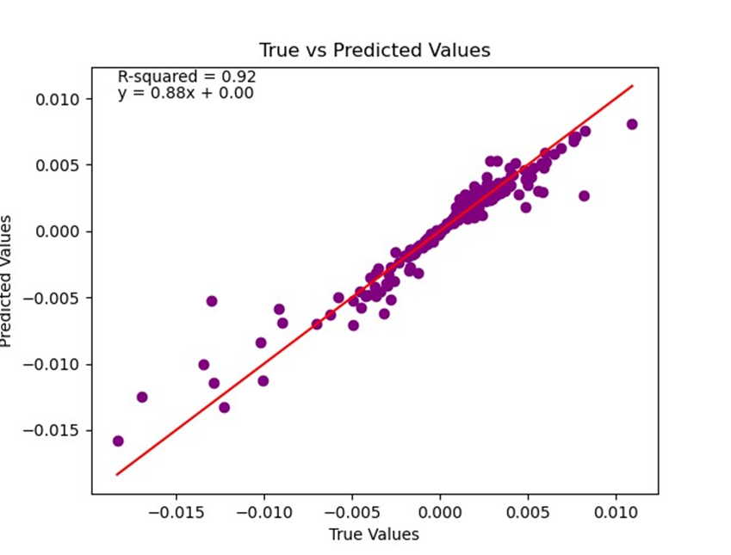
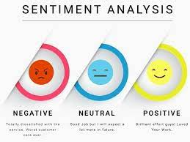
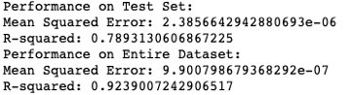
Methodology (cont.)
Random Forest (RF) model (avg. quarterly data) =
predict quarterly stock return (volume, Sharpe Ratio)
initial linear regression no good
Sentiment analysis tool (Python) =
short-term score for each stock

Slide 8
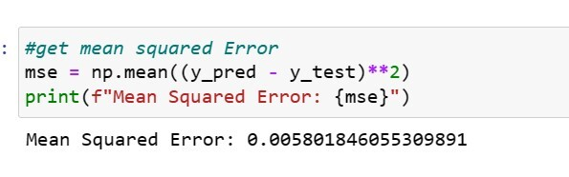

Methodology (cont.)
Long Short Term Memory (LSTM) model (daily stock price data) =
predict daily stock returns
initial Multiclass Perceptron (MLP) model (classification model no good)
Flask routes, chatbot on a webpage (stock name, daily price & volume) =
Dashboard = future daily, quarterly returns + overall sentiment score

Slide 9
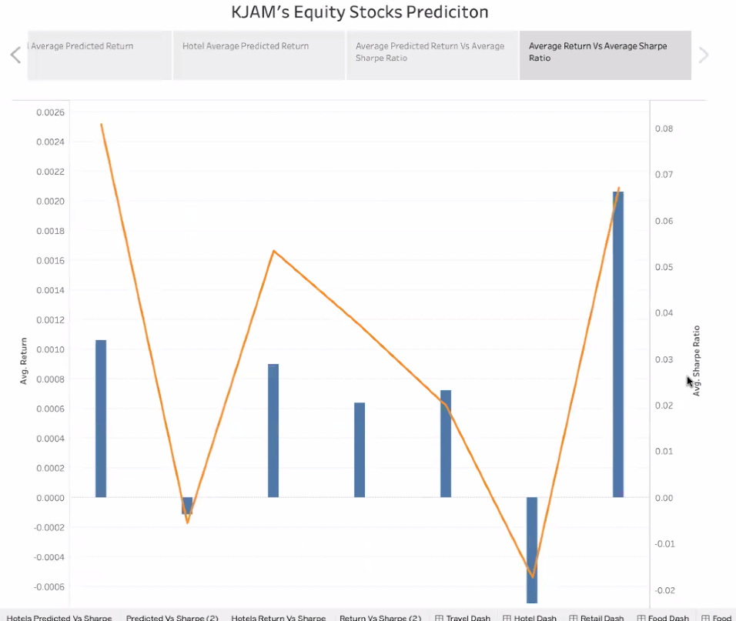
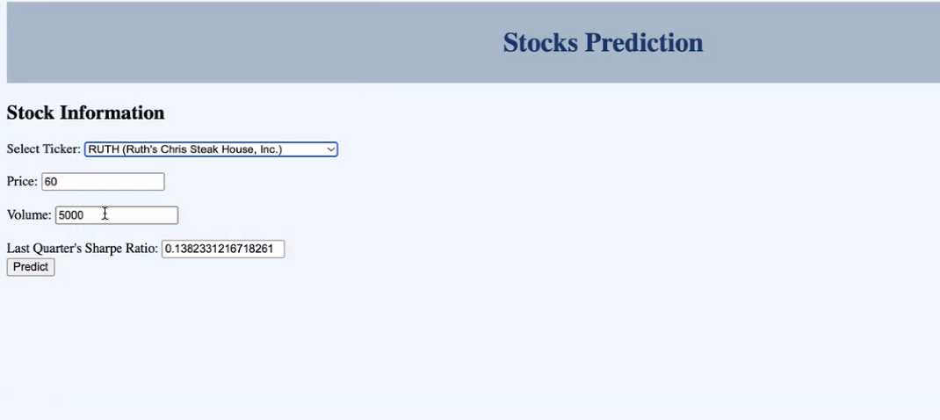
Data Visualization
Tableau look
User Dashboard look

Slide 10
Conclusion
Quarterly model (w/ sentiment analysis included) best for predictions
Linear regression model not suited well for time-series data (x vs. y variable varies over time)
Daily stock data too noisy for deep learning (separate model for each stock recommended)
Significant post COVID-19 recovery and growth for travel stocks

